Slide 1
STUDY ABROAD PARTICIPATION (2014–2025)*
University of the Pacific – Global Education Office
*Only available data was used in this study. A few years are missing recrods, as well as impacted by Covid-19.

Slide 2
Objectives 1
Track Participation Trends (2014–2025):
Analyzing study abroad interest over time by term, school, and major.
Identify Key Contributors:
Highlighting top UOP schools and majors from which students go abroad.
Support Equity & Inclusion:
Examining participation by gender and ethnicity to address underrepresentation.
Guide Strategic Planning
Enabling data-driven decisions for partnerships, outreach, and program improvements.

Slide 3

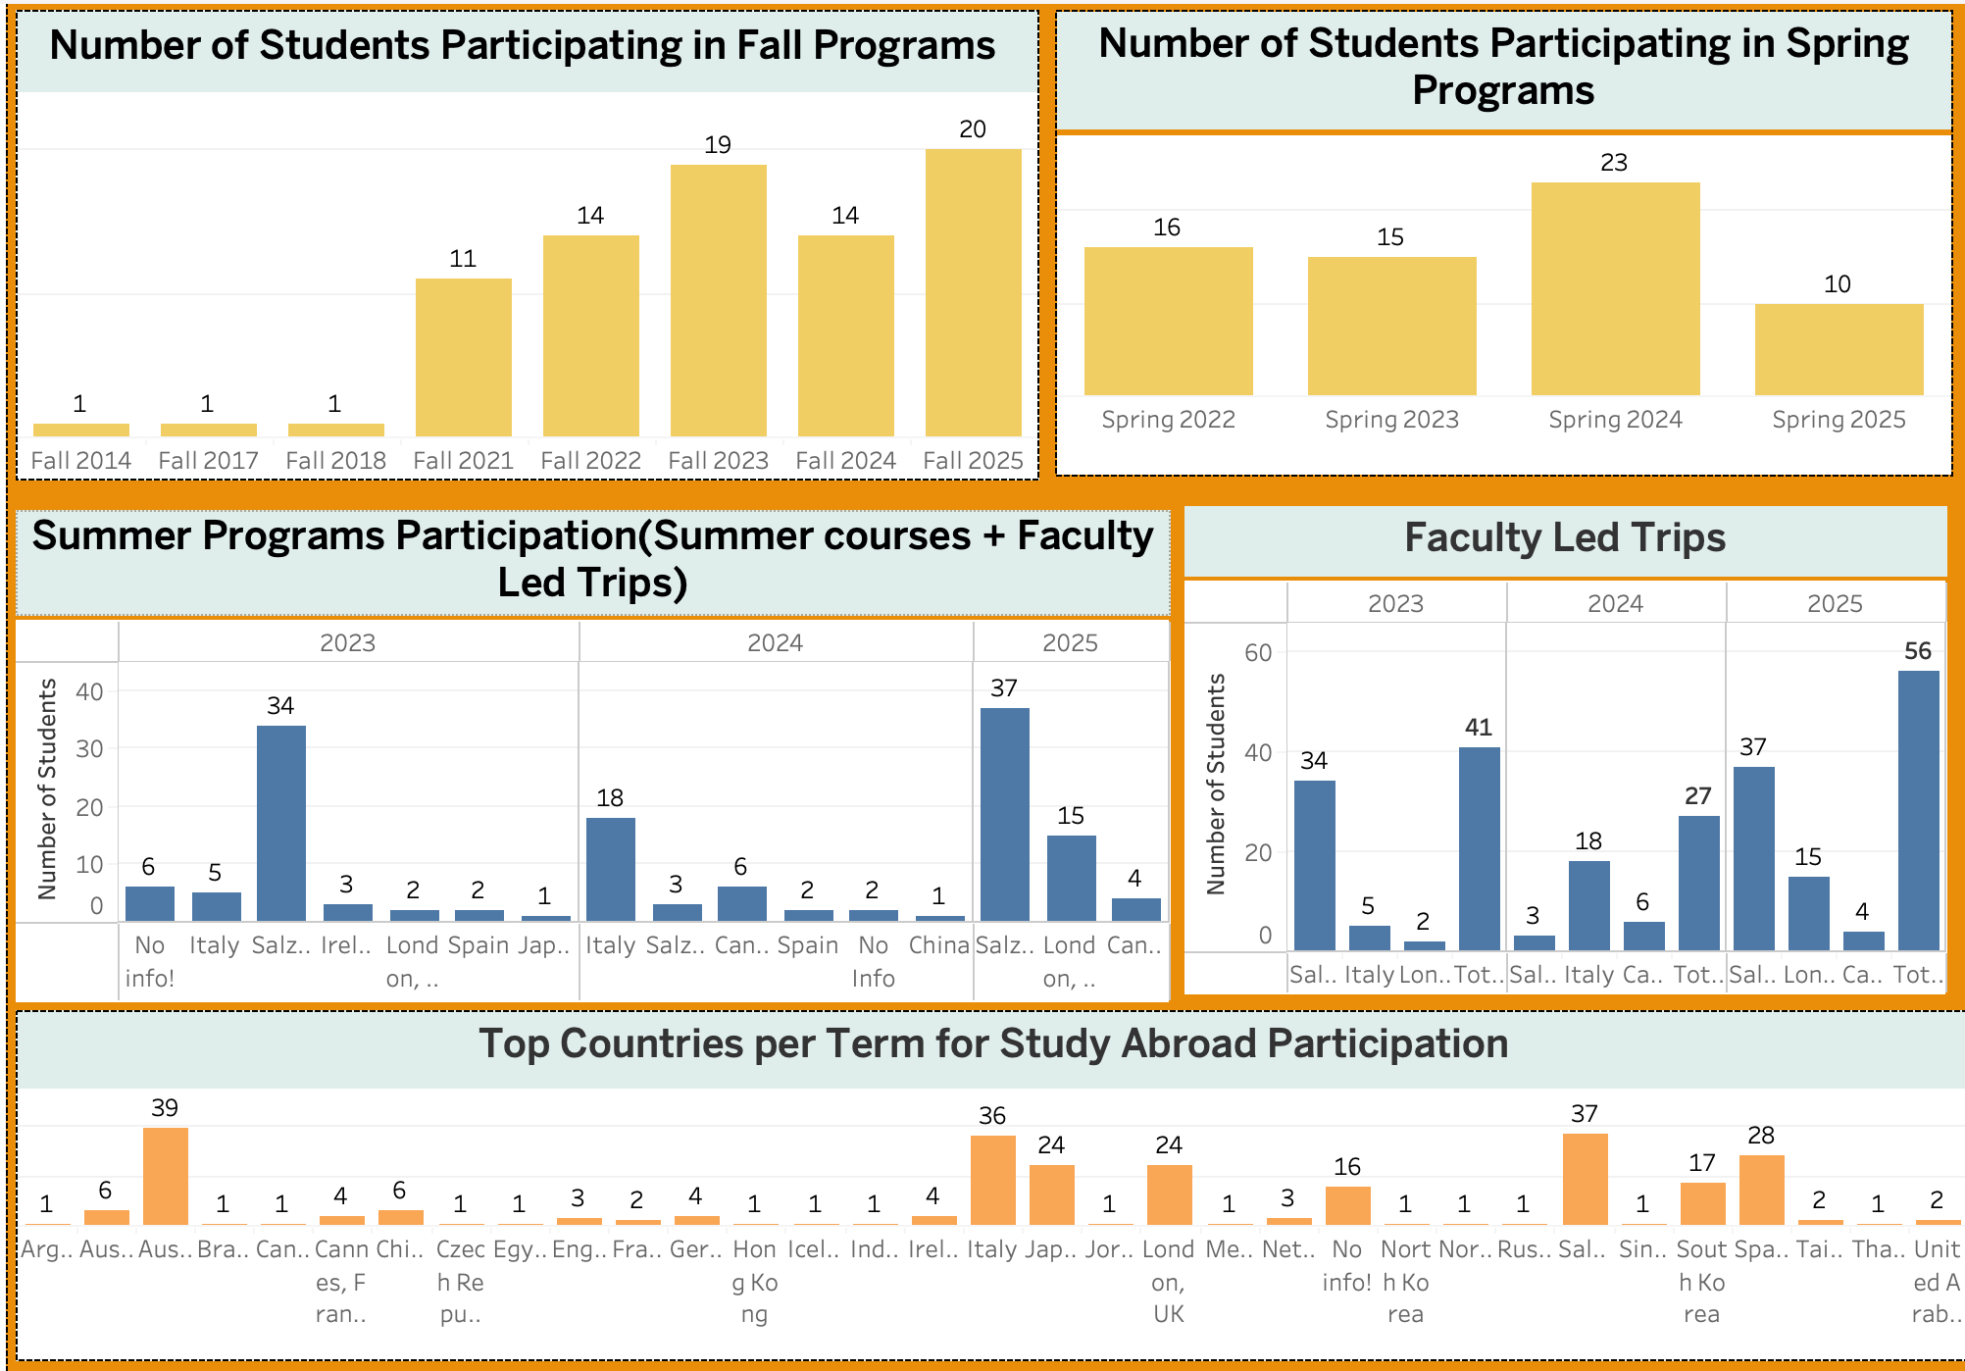
Objectives 2

Slide 4
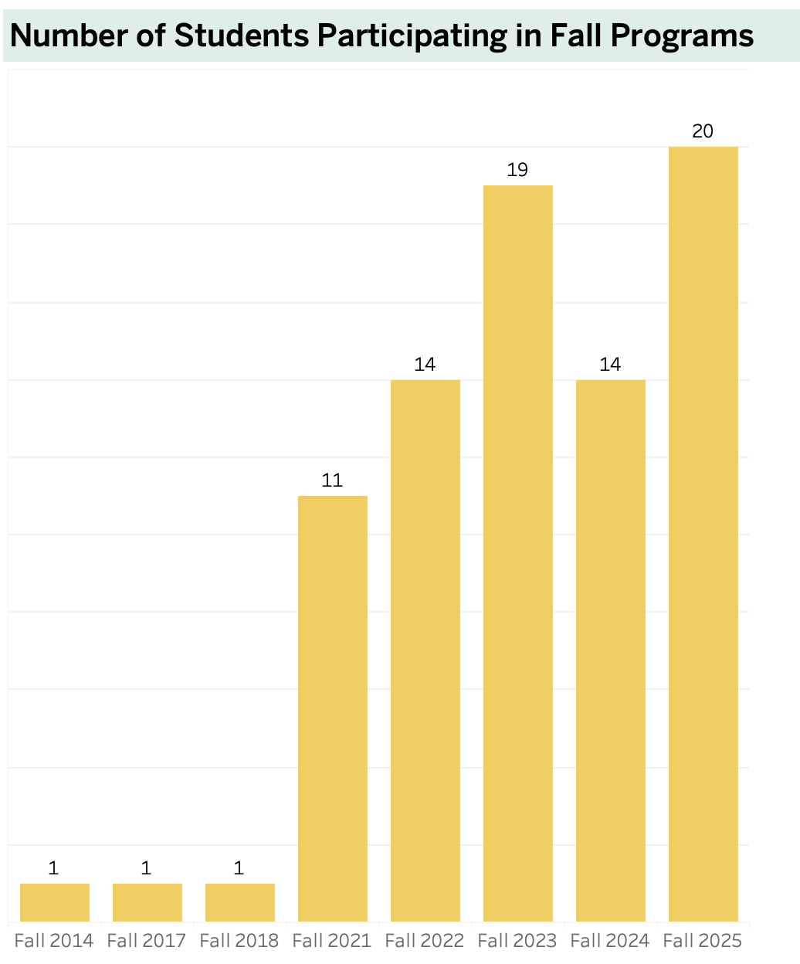
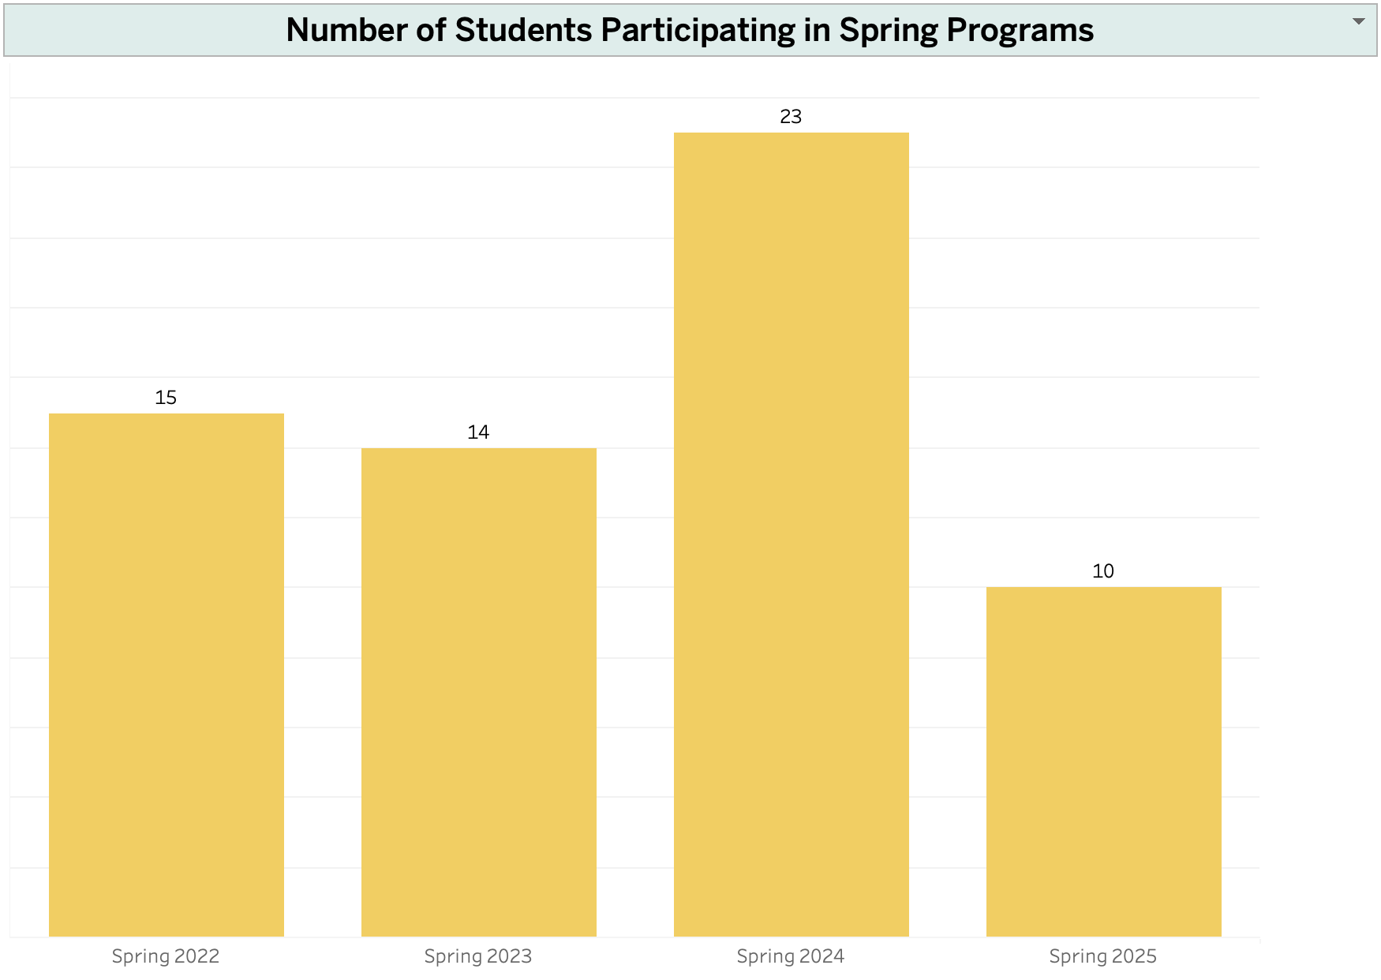
Number of Students Participating in Spring & Fall Programs
Fall Program Participation (2014–2025)
Gradual increase over the years and highest participation in Fall 2025 from 14 to 20 students
Spring Program Participation (2022–2025)
Peak in Spring 2024 with 23 students and Slight drop in Spring 2025. Significant boost in participation expected for Spring 2026.

Slide 5
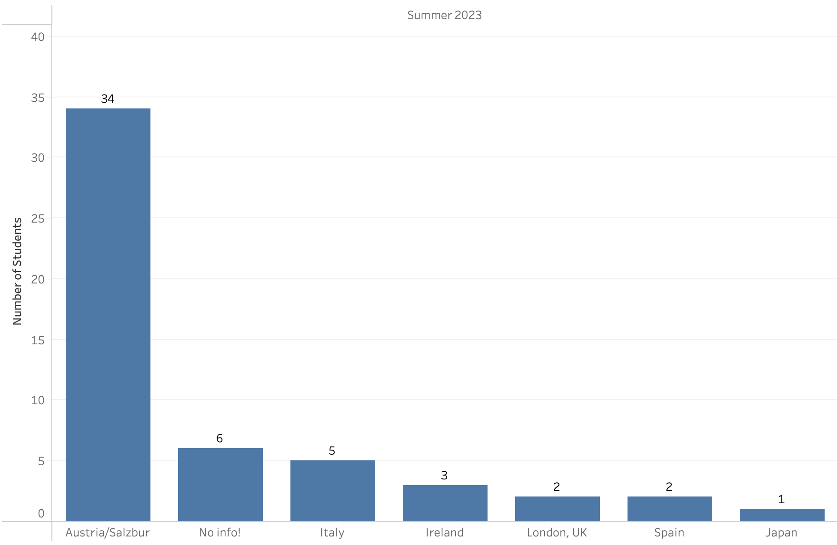
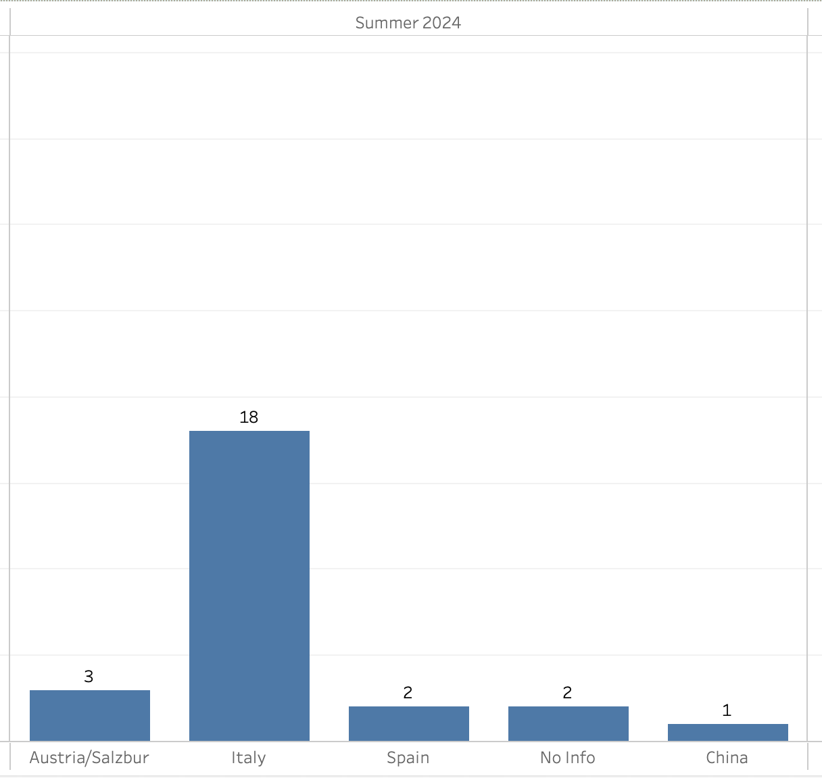
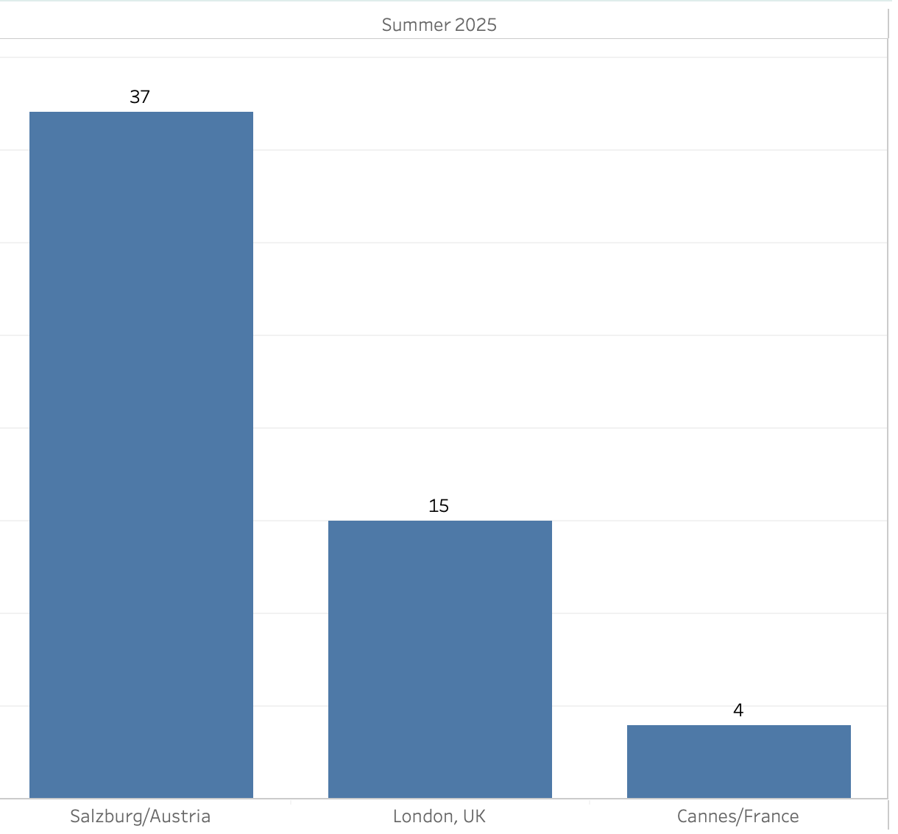
Student Participation in Summer Programs ​
(Faculty led trips + Summer Study Abroad)
Of the Faculty-led trips, Salzburg/Austria had the highest participation in both 2023 (34) and 2025 (37).

Slide 6
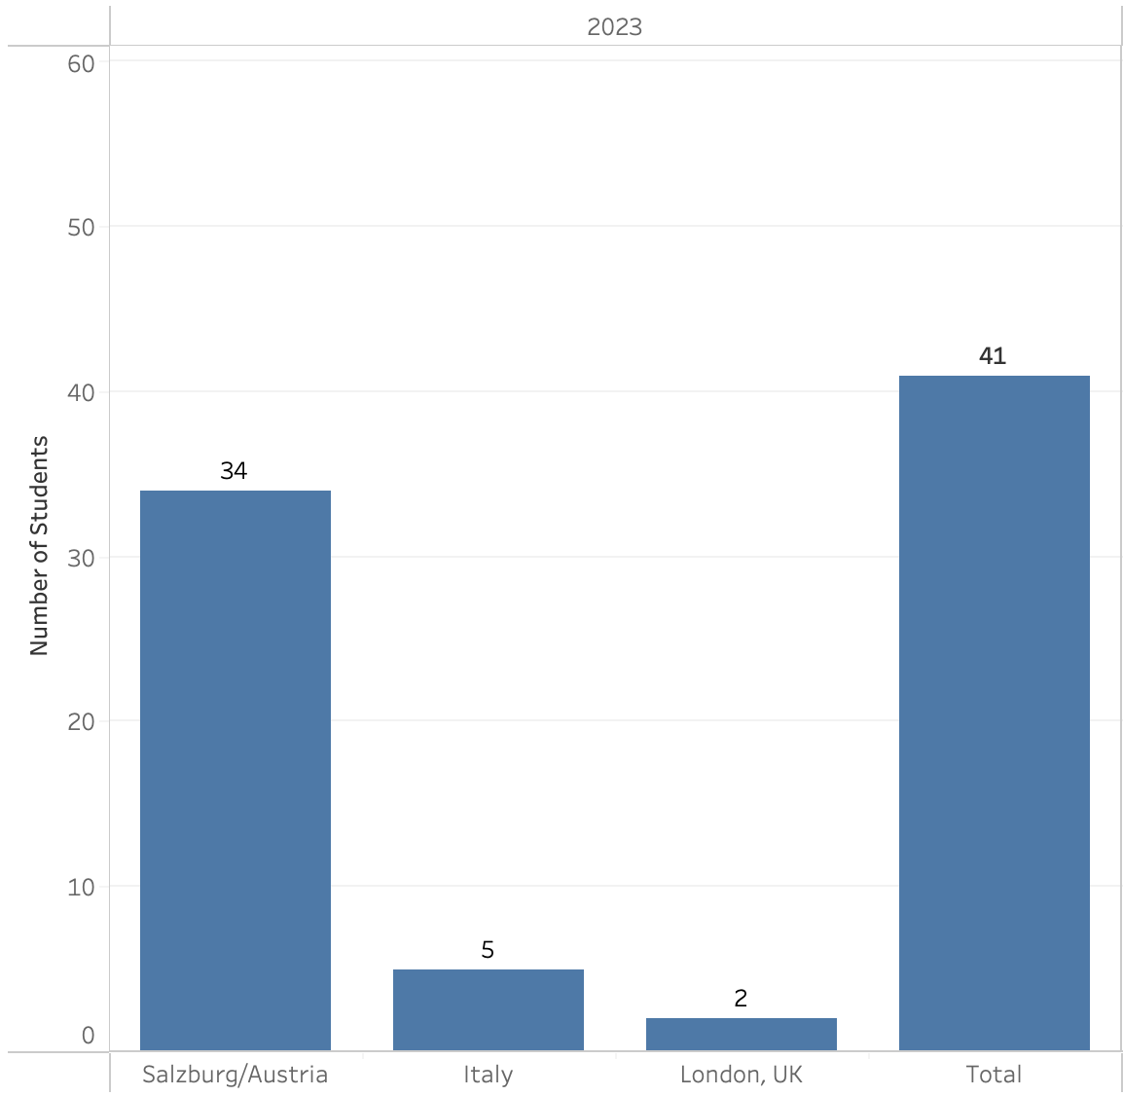
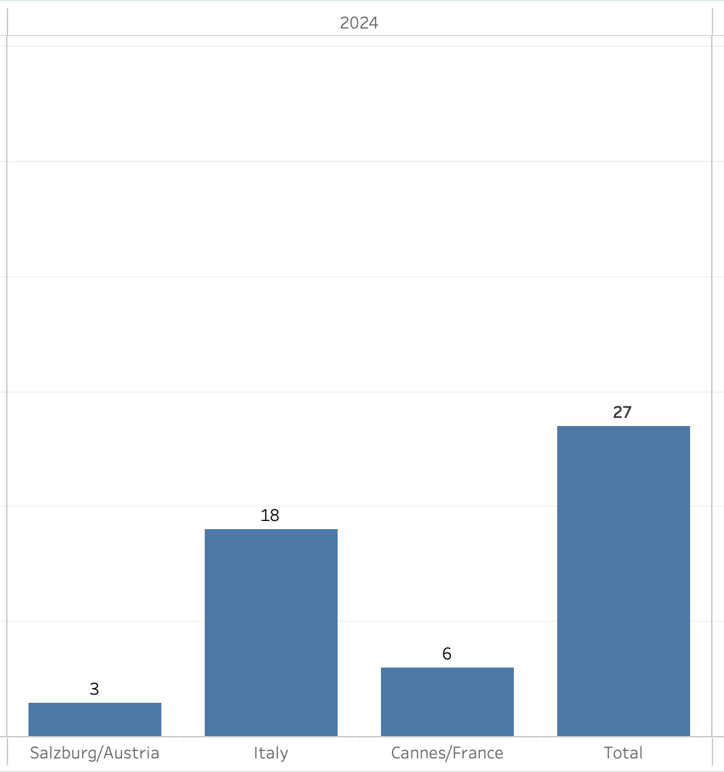
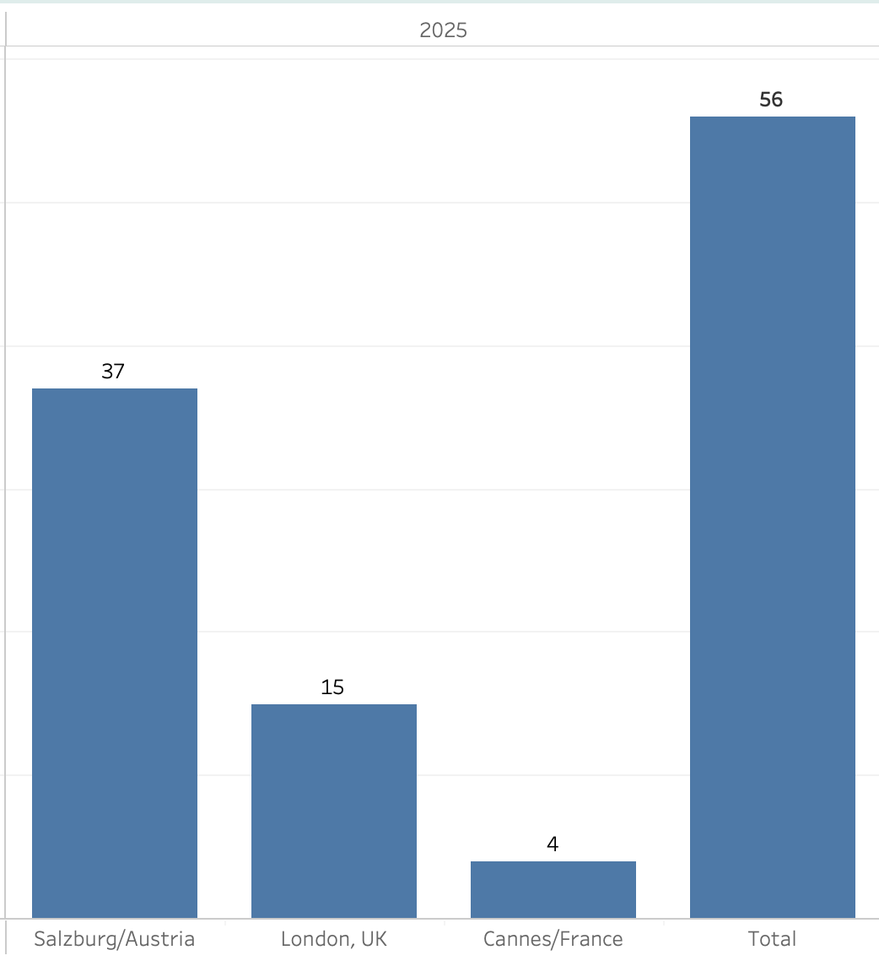
Faculty-Led Study Abroad Trips: 2023–2025​

Slide 7
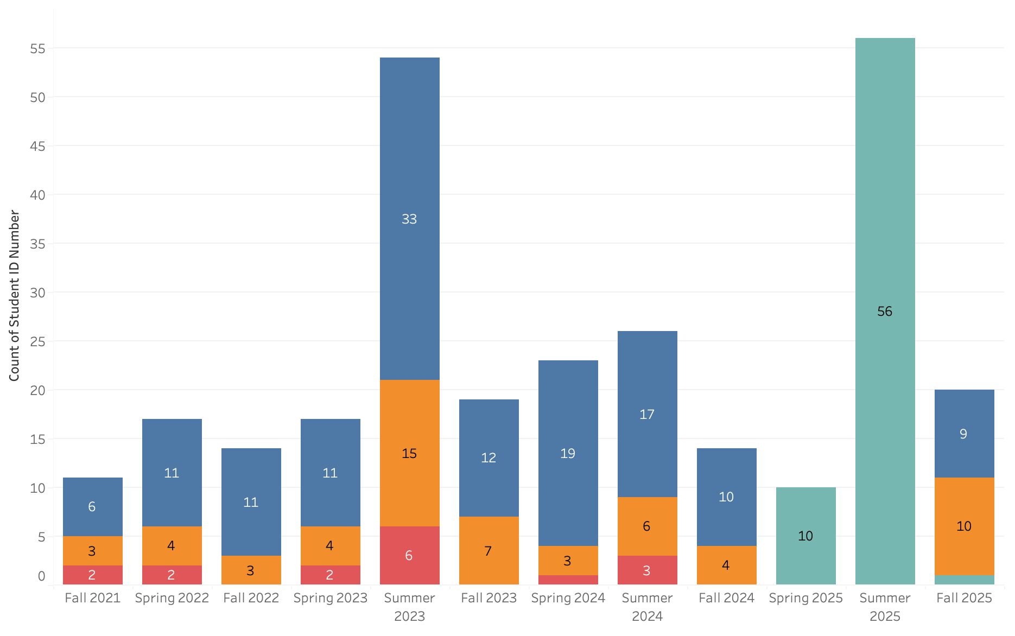
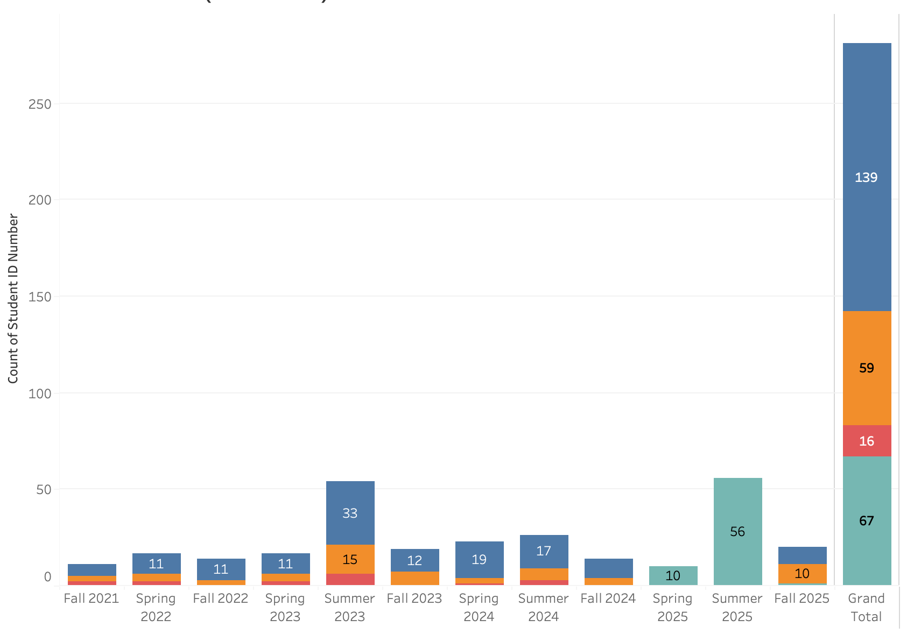
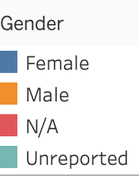
Gender Distribution (2021-2025)

Slide 8
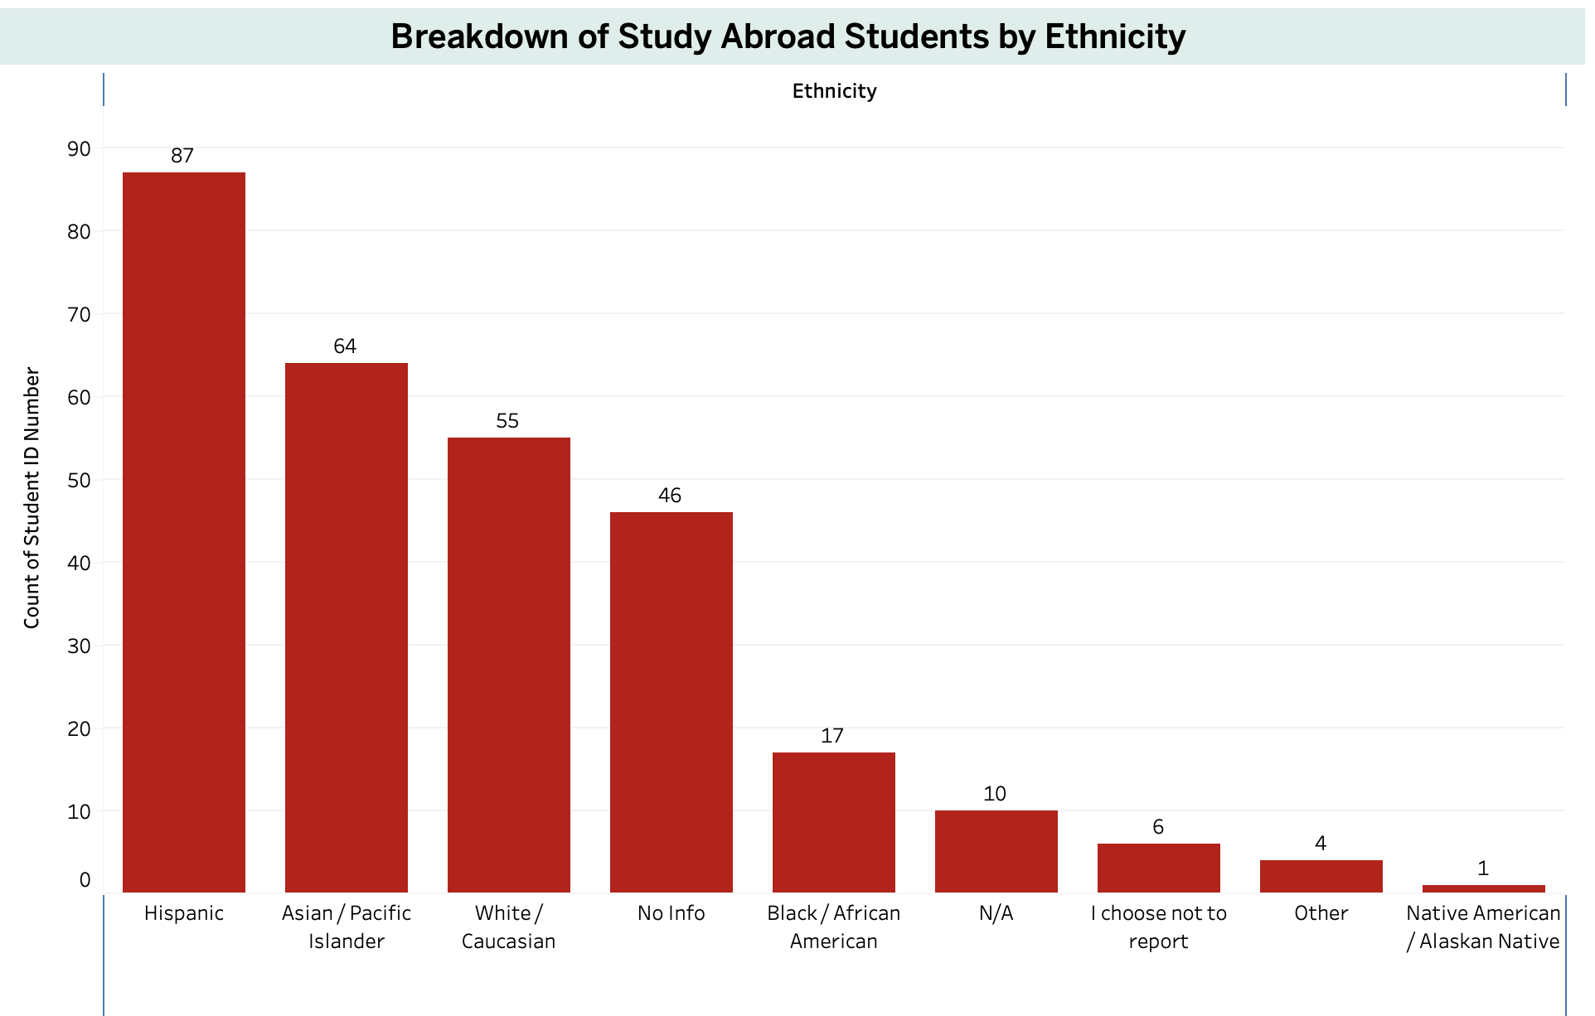
Ethnic Diversity in Study Abroad Participation (2014–2025)
Hispanic and Asian/Pacific Islander students are among the top reported participants.
Few number of students (6) did not provide ethnicity information.
Hispanic students represent the highest reported group and then Asian/Pacific Islanders.
Participation from Black/African American and other underrepresented groups remains lower.

Slide 9
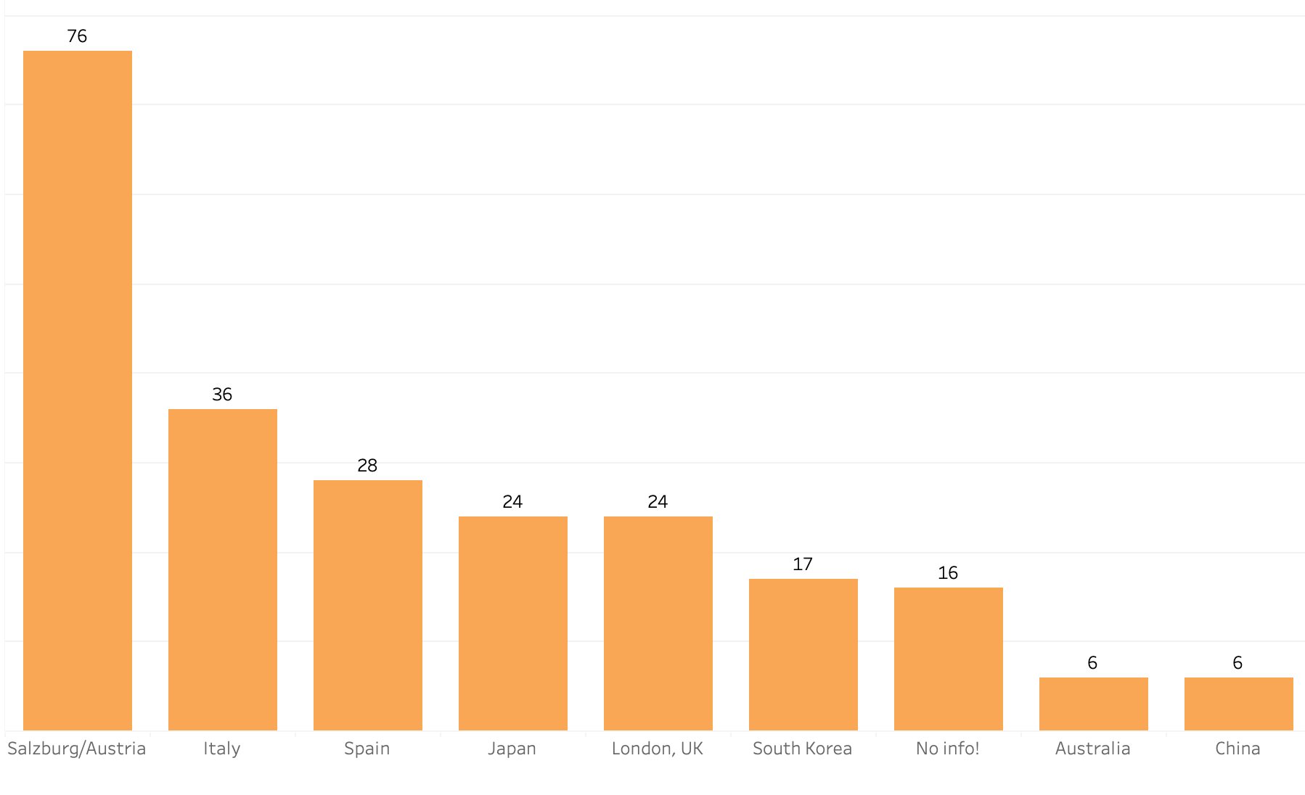
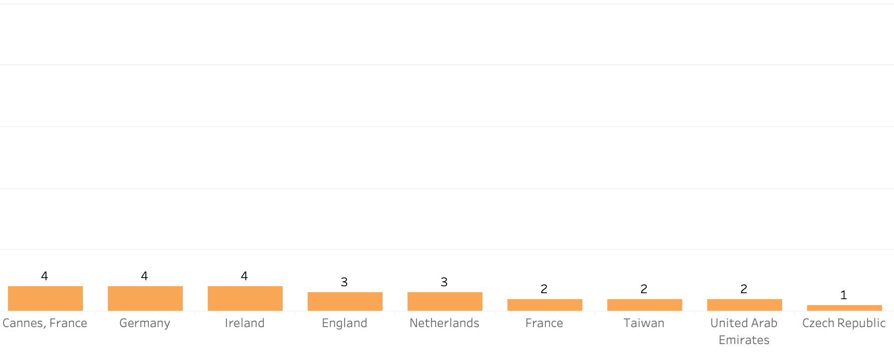
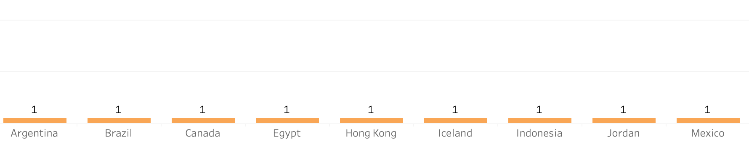
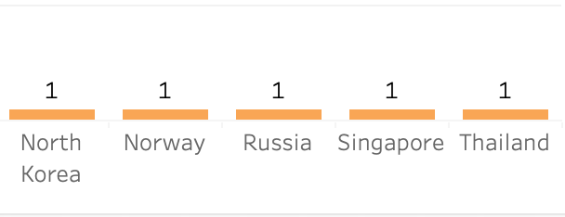
Top Countries per Term for Study Abroad Participation

Slide 10
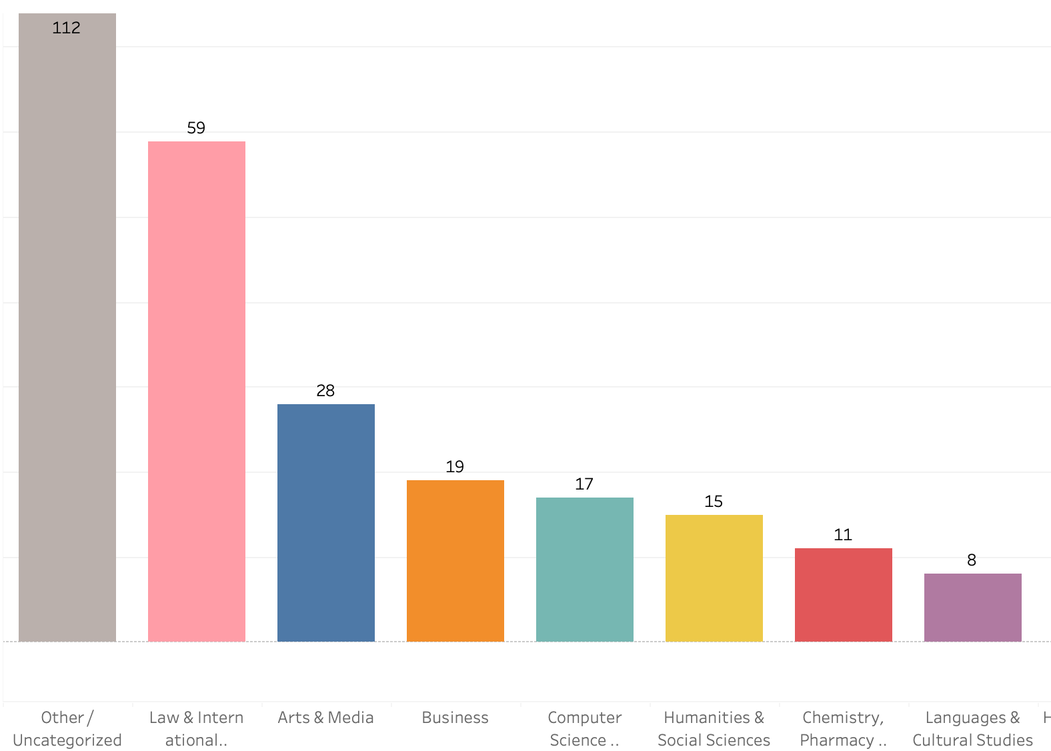
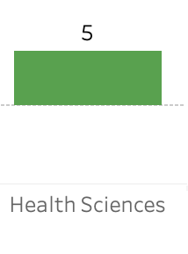
Student Majors Participating in Study Abroad (Fall and Spring)
Top participation from Arts, Media (23), Law (18) and Business (17).
Moderate participation in Engineering and Computer Science with 14 students.
Lower engagement from Health Science , Chemistry, Medical and Pharmacy majors.
Large “Other” group suggests significant interest from “undeclared” students.
Of note, International Studies no longer exists as a separate school, but it’s historical data is recorded here.

Slide 11
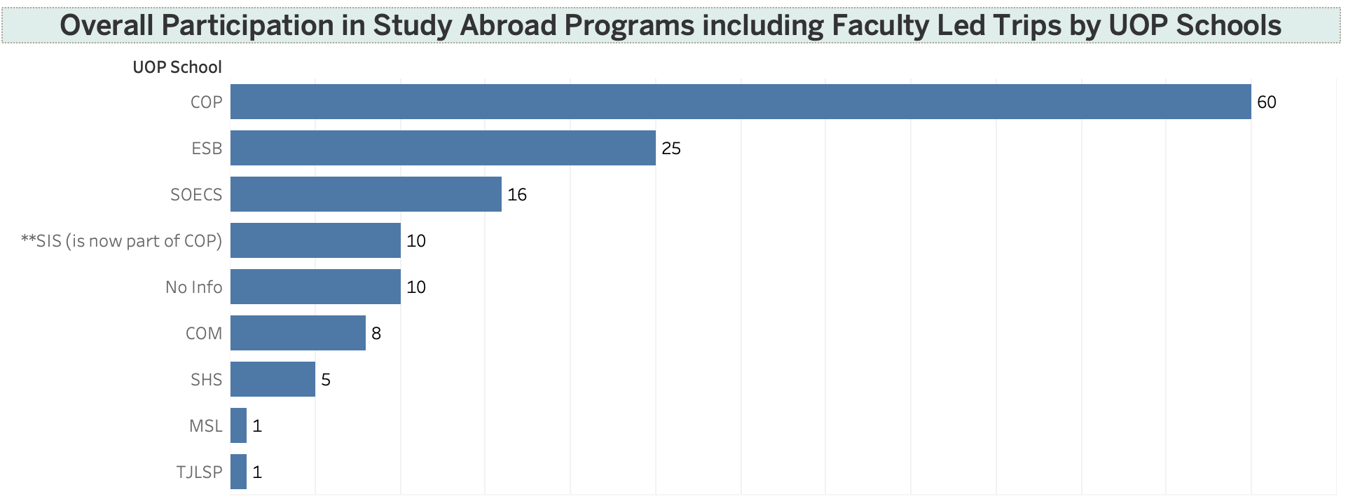
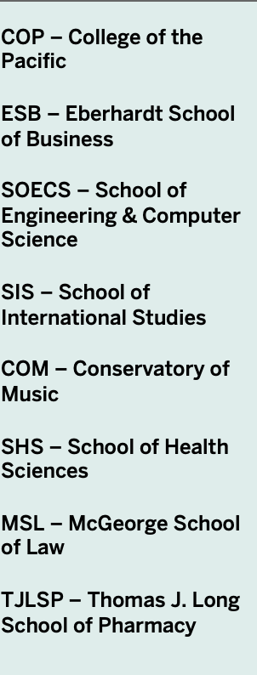
Top UOP Schools Sending Students Abroad
College of the Pacific (COP) leads with the highest number of participants (86).
McGeorge School of Law (MSL), Eberhardt School of Business (ESB), and School of Engineering & Computer Science (SOECS) show strong engagement.
No Info remains significant, suggesting a need for improved data collection.
Smaller contributions come from the Conservatory of Music (COM), School of Health Sciences (SHS), Thomas J. Long School of Pharmacy (TJSLP), and School of International Studies (SIS).

Slide 12
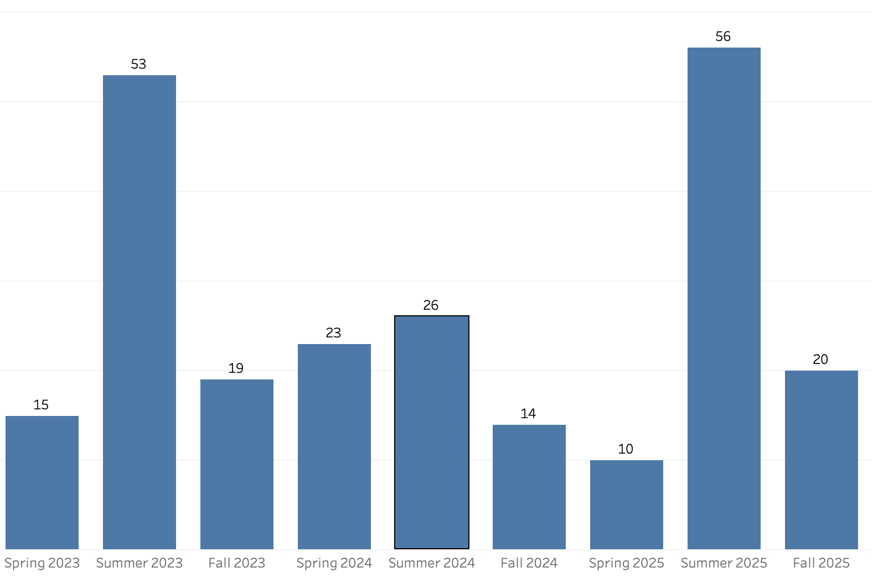
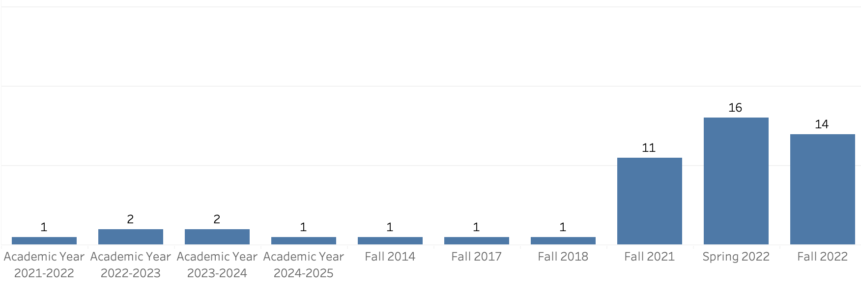
Overall Participation in Study Abroad Programs (including Fall, Spring, Summer and Faculty Led Trips)
Notable rise in participation from Fall 2021 onward.
Summer terms saw the highest engagement—Summer 2023 (48) and Summer 2025 (56).
Fall 2025 also shows strong interest with 20 students.
Suggests growing momentum in study abroad programs, especially during summer.

Slide 13
Final Considerations
Analysis shows that participation has been fairly consistent over the years, but still needs substantial growth.
There are relatively few faculty led trips, of which Salzburg is the most popular.
Deeper conversations are suggested to surmise why overall participation is low in comparison to similar programs at other U.S. institutions.
Certain ethnic groups are highly underrepresented (i.e. Black students) and should be engaged more.
Some schools are also underrepresented due to specific program requirements (e.g. Nursing, Dental, etc.).
Law school also has specific requirements, but they have an integrated SABD program. Other schools may follow this model.
20 more students should be added to 2025 due to the upcoming “First Year Abroad: Chile” trip.
Total number of students participating in study abroad 2014-2025 is 310, excluding uncomputed years (2015-22), making an average of 77.5 students per year.

